Slide 1
E-commerce website with payment portal

Slide 2
Contents
Problem Statement
Scope and importance
Diagrams
User Stories implemented

Slide 3
Problem Statement
To create a secure E-commerce website with payment portal that implements protocol aimed that puts user’s security at the forefront

Slide 4
Scope
With the world moving to a digital environment, the number of cyber-attacks has increased. E-Shopping being a common attack ground, it is important that we learn security and safety measures.
In this project, we try to make an E-commerce website with basic functionalities and try to implement a payment portal using Secure Electronic Transfer (SET) protocol.

Slide 5
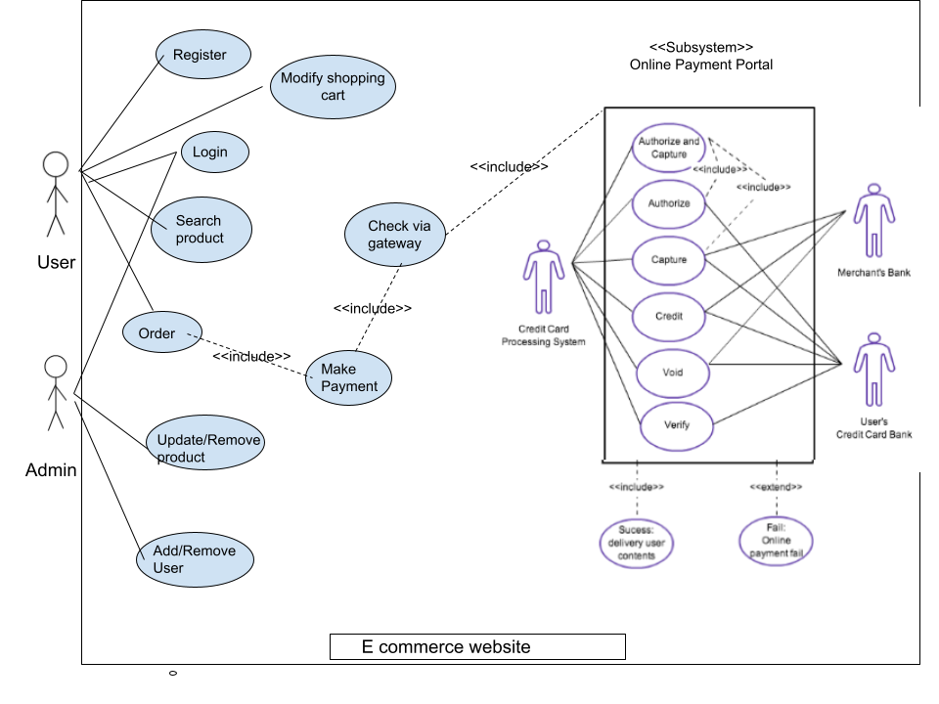
Use Case Diagram

Slide 6
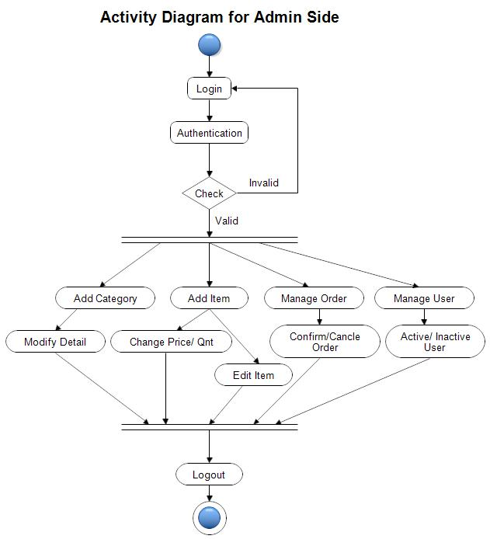
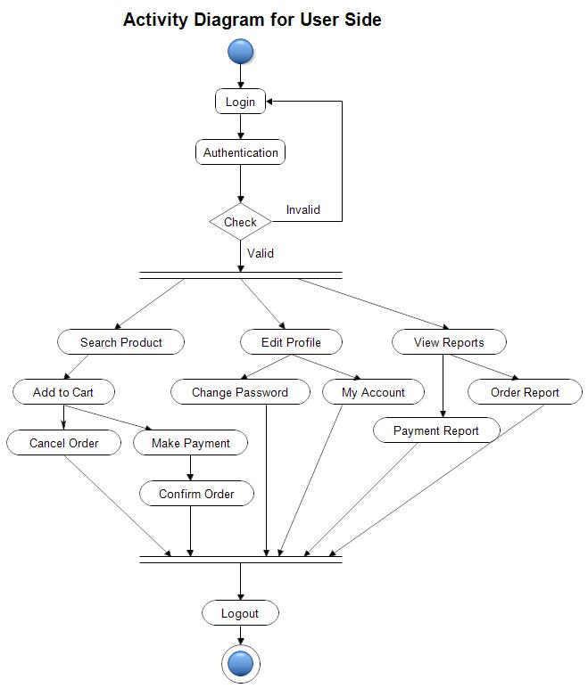
Activity Diagram

Slide 7
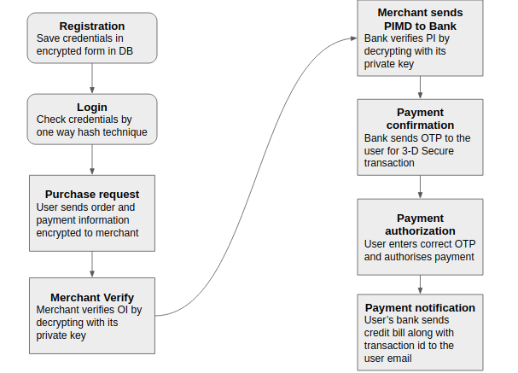
Activity Diagram
Payment Portal

Slide 8
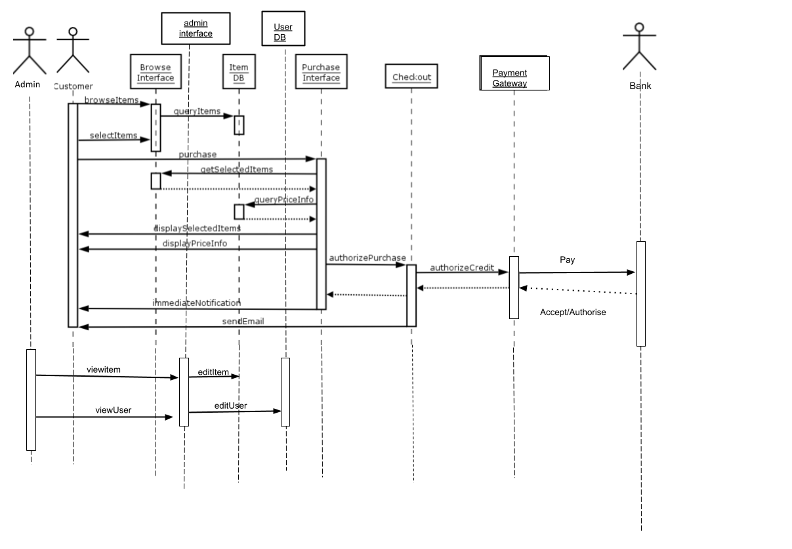
Sequence Diagram

Slide 9
Innovation
In normal cases OTP would be sent only to mobile
We are trying to implement a two part OTP where 1 part of OTP is sent to mail and other to mobile, and only if you have both can you make the payment
This would implement double layer protection

Slide 10

Thank you!

